Slide 1

ONLINE RETAIL CUSTOMER SEGMENTATION Akashpati Mishra
.

Slide 2
CONTENT:
Problem Statement
Understanding Customer Segmentation
Data Description
Data Summary
Exploratory Data Analysis
RFM Model Analysis
Silhouette
K Means and DBSCAN
Hierarchical Clustering
Summary
Conclusion

Slide 3
PROBLEM STATEMENT
In this project, your task is to identify major customer segments on a transnational data set which contains all the transactions occurring between 01/12/2010 and 09/12/2011 for a UK-based and registered non-store online retail. The company mainly sells unique all-occasion gifts. Many customers of the company are wholesalers.

Slide 4
UNDERSTANDING CUSTOMER SEGMENTATION
Customer segmentation is the process of separating customers into groups on the basis of their shared behavior or other attributes. The groups should be homogeneous within themselves and should also be heterogeneous to each other. The overall aim of this process is to identify high-value customer base i.e. customers that have the highest growth potential or are the most profitable.
Insights from customer segmentation are used to develop tailor-made marketing campaigns and for designing overall marketing strategy and planning.

Slide 5
Data Description Attribute Information:
InvoiceNo: Invoice number. Nominal, a 6-digit integral number uniquely assigned to each transaction. If this code starts with letter 'c', it indicates a cancellation.
StockCode: Product (item) code. Nominal, a 5-digit integral number uniquely assigned to each distinct product.
Description: Product (item) name. Nominal.
Quantity: The quantities of each product (item) per transaction. Numeric.
InvoiceDate: Invoice Date and time. Numeric, the day and time when each transaction was generated.
UnitPrice: Unit price. Numeric, Product price per unit in sterling.
CustomerID: Customer number. Nominal, a 5-digit integral number uniquely assigned to each customer.
Country: Country name. Nominal, the name of the country where each customer resides.

Slide 6
Data Summary
Datatype of InvoiceDate is object need to convert it into datetime.
If InvoiceNo starts with C means it's a cancellation. We need to drop this entries.
There are null values in CustomerID and Description.
After removing null values our data got reduced. So we have 8 features and 406829 columns.

Slide 7
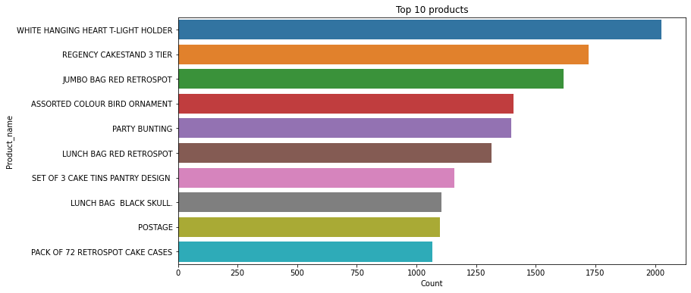
EDA
Top 10 items in terms of description(Name):
WHITE HANGING HEART T-LIGHT HOLDER is the highest selling product almost 2018 units were sold.
REGENCY CAKESTAND 3 TIER is the 2nd highest selling product almost 1723 units were sold.

Slide 8
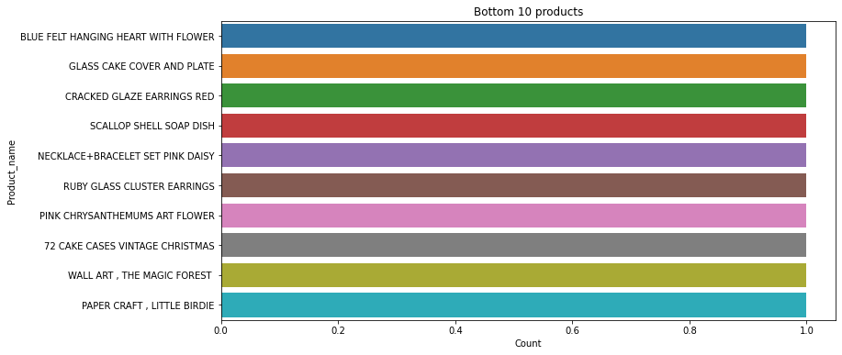
Bottom 10 items in terms of description(Name)
Paper craft, wall art, 72 cake cases are the lowest selling product.

Slide 9
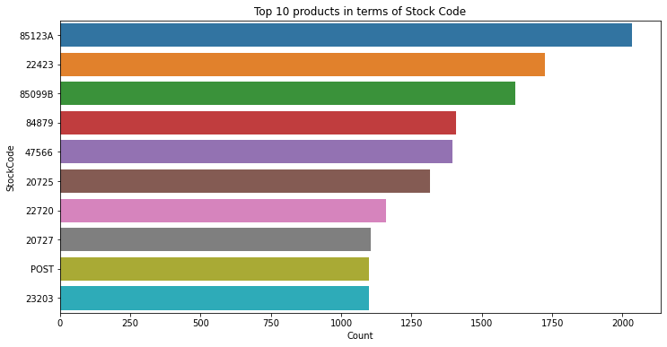
Top 10 items in terms of StockCode
StockCode-85123Ais the first highest selling product.
StockCode-22423 is the 2nd highest selling product.

Slide 10
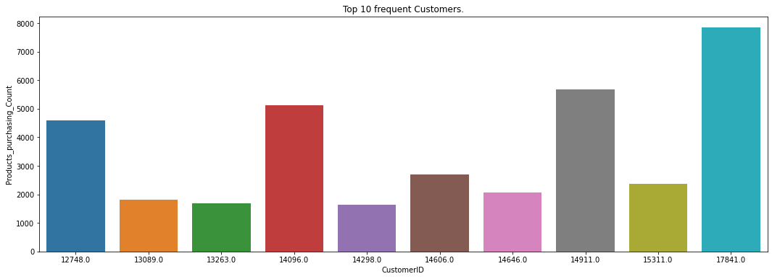
Top 10 frequent Customer
CustomerID- 17841 had purchased highest number of products
CustomerID-14911 is the 2nd highest customer who purchased the most the products

Slide 11
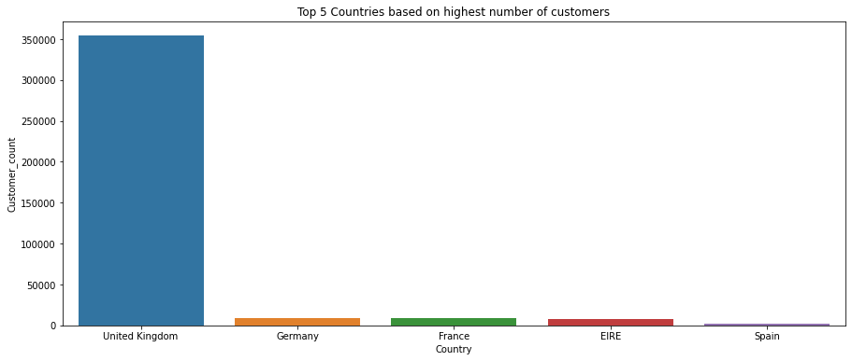
Top 5 countries where max sell happen
UK has highest number of customers.
Germany, France and Irelands has almost equal number of customers.

Slide 12
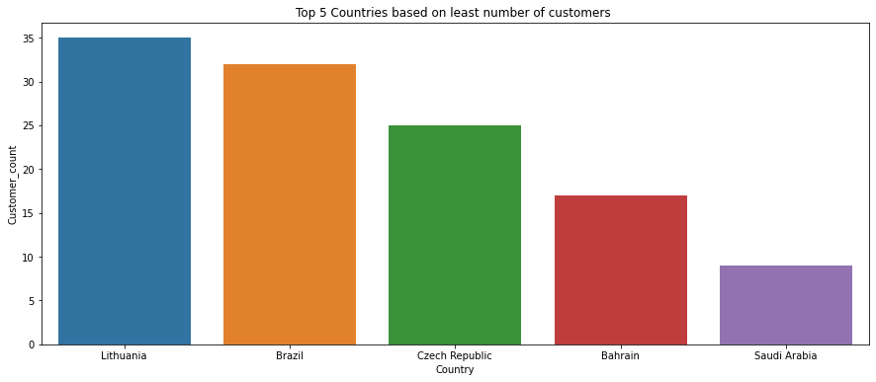
Bottom 5 countries where max sell happens
There are very less customers from Saudi Arabia
Bahrain is the 2nd Country having least number of customers

Slide 13
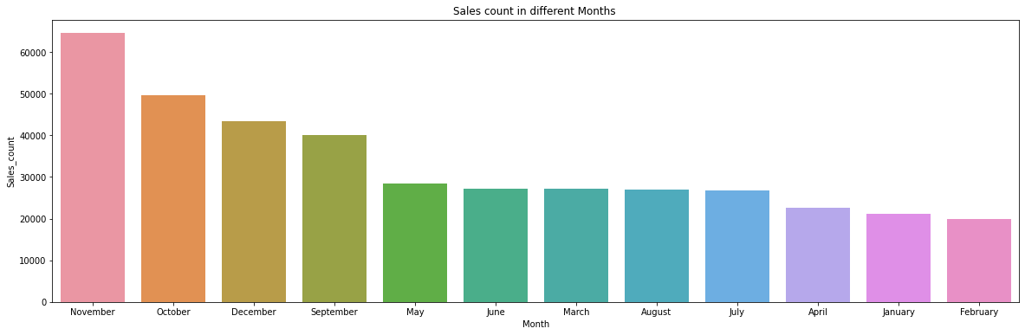
Sales count in different months
Most of the sale happened in November month.
February Month had least sales.

Slide 14
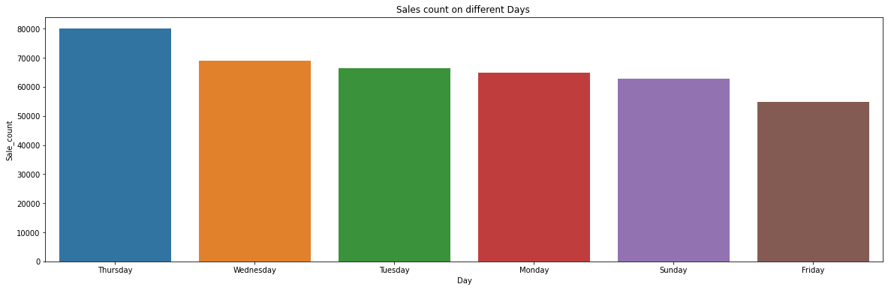
Sales count on different days
Sales On Thursdays are very high.
Sales On Fridays are very less.

Slide 15
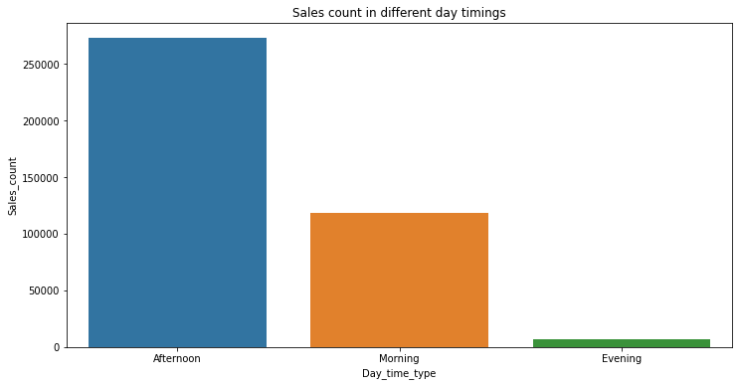
Sales count in different day timing
Most of the sales happens in the afternoon.
Least sales happens in the evening.

Slide 16
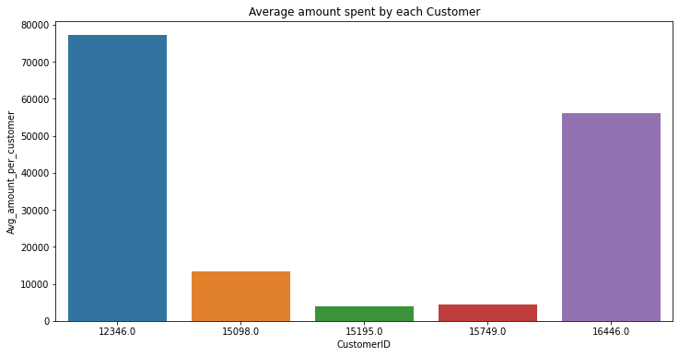
Average amount spent by each customers
77183 (Dollars)is the highest average amount spent by the CustomerID-12346
56157 (Dollars) is the 2nd highest average amount spent by the CustomerID-16446

Slide 17
RFM Model Analysis: What is RFM?
RFM is a method used to analyze customer value. RFM stands for RECENCY, Frequency, and Monetary. RECENCY: How recently did the customer visit our website or how recently did a customer purchase?
Frequency: How often do they visit or how often do they purchase?
Monetary: How much revenue we get from their visit or how much do they spend when they purchase?

Slide 18
Why it is Needed?
RFM Analysis is a marketing framework that is used to understand and analyze customer behavior based on the above three factors RECENCY, Frequency, and Monetary.
The RFM Analysis will help the businesses to segment their customer base into different homogenous groups so that they can engage with each group with different targeted marketing strategies.

Slide 19
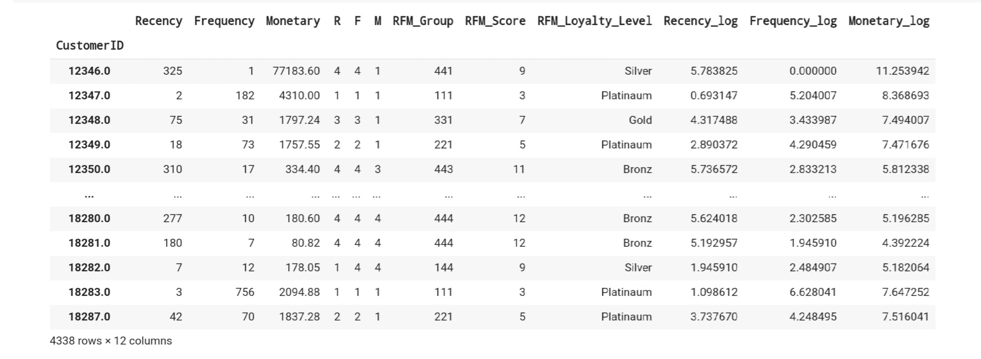
RFM Model
Recency = Latest Date - Last Invoice Data,
Frequency = count of invoice no. of transaction(s),
Monetary = Sum of Total
Lower the recency, good for the company.
Higher value of frequency and monetary lead to a good consumer. Here higher value = 1 in reverse way

Slide 20
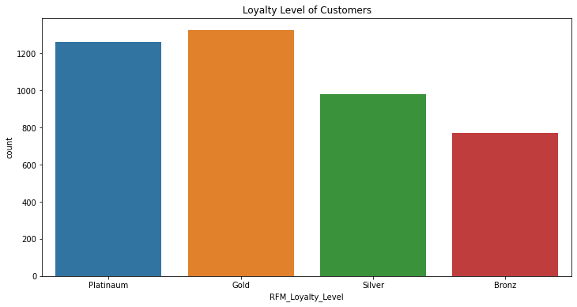
Loyalty level of customers
As we see gold customers are higher and platinum is second highest.
Bronze customers are less than all

Slide 21
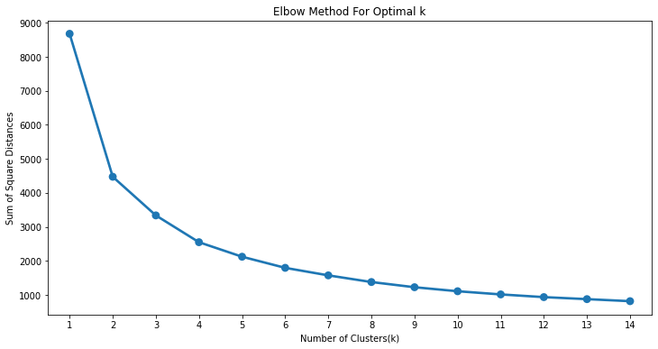
K-Means Clustering
Recency and Monitory
Elbow method
Before implementing the Kmeans Clustering algorithm we need to decide the number of clusters to put inside algorithm as input. So we will be finding the minimum number of clusters required by using Elbow method.
Here we see optimal value of cluster comes out to be 2.

Slide 22
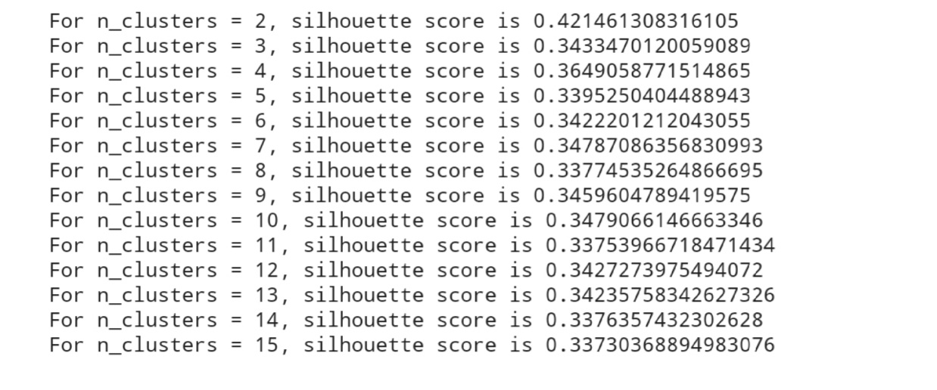
Silhouette Score
Here we can see the for n_cluster=2 silhouette score is good as compared to others.(if values is close to 1 means data points are clustered very well to respective clusters and distance of that data point is very far from the other cluster.)

Slide 23
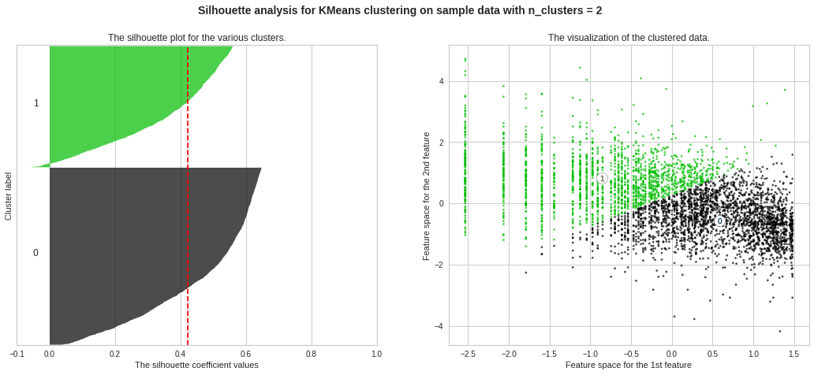
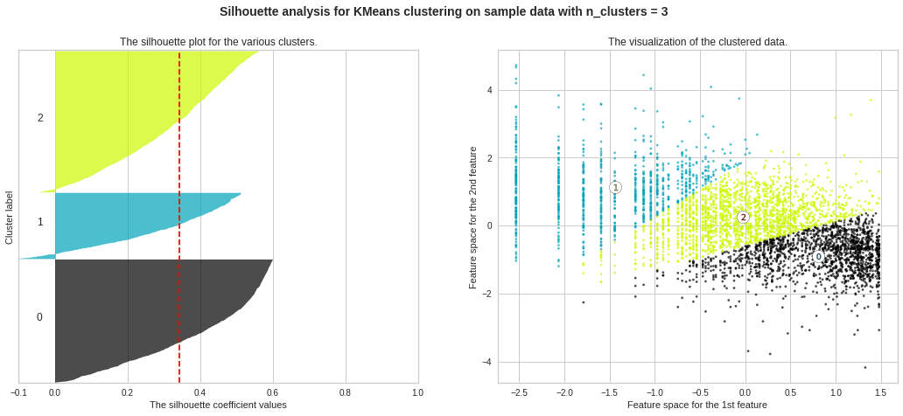
Silhouette analysis for Kmeans with n_clusters

Slide 24
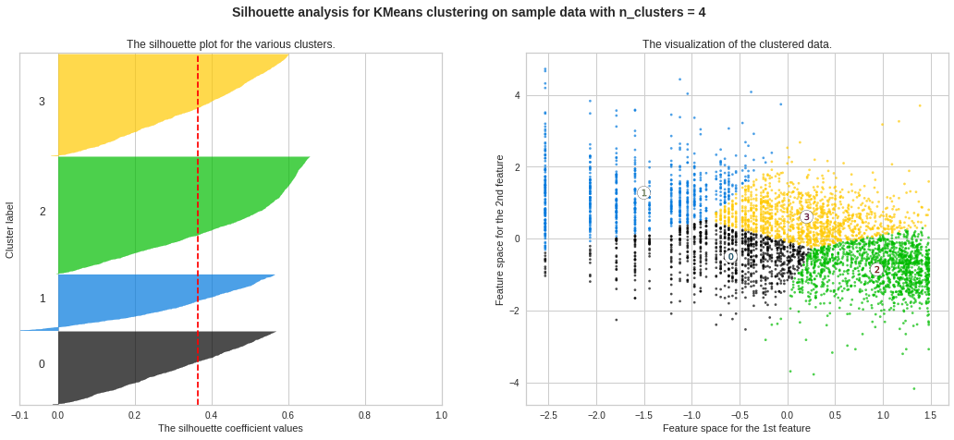
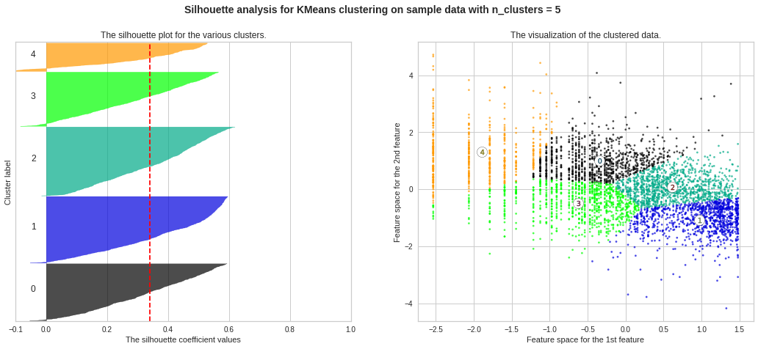

Slide 25
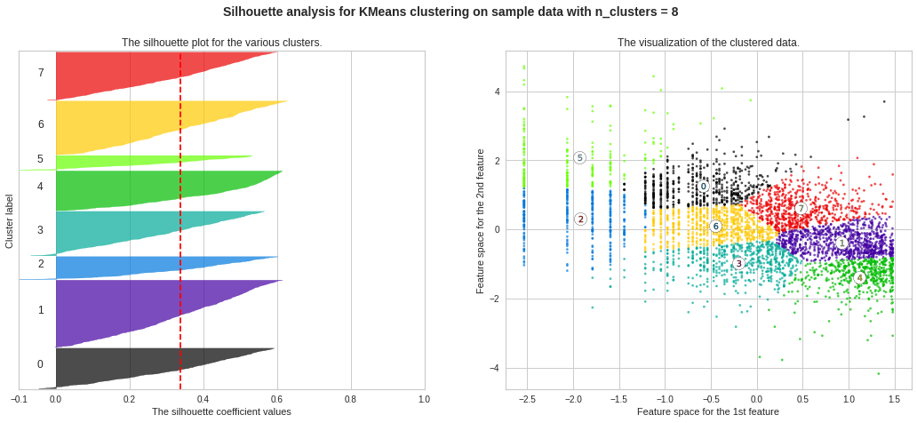
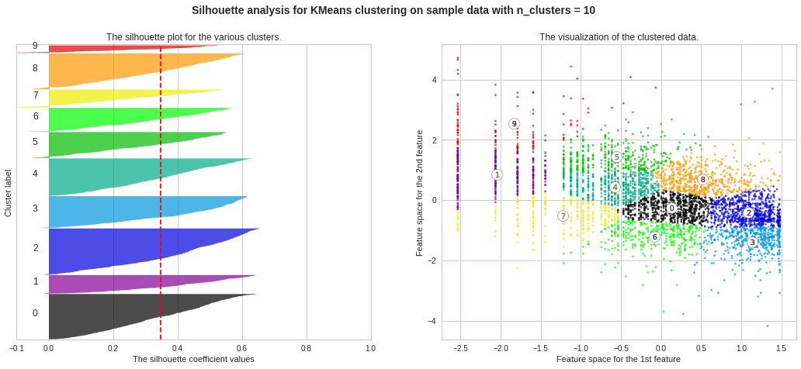
.
We got good Silhouette plot for Cluster-2 but still few data points are on the negative side of the Silhouette Coefficient value as shown in below figure. but its better than others

Slide 26
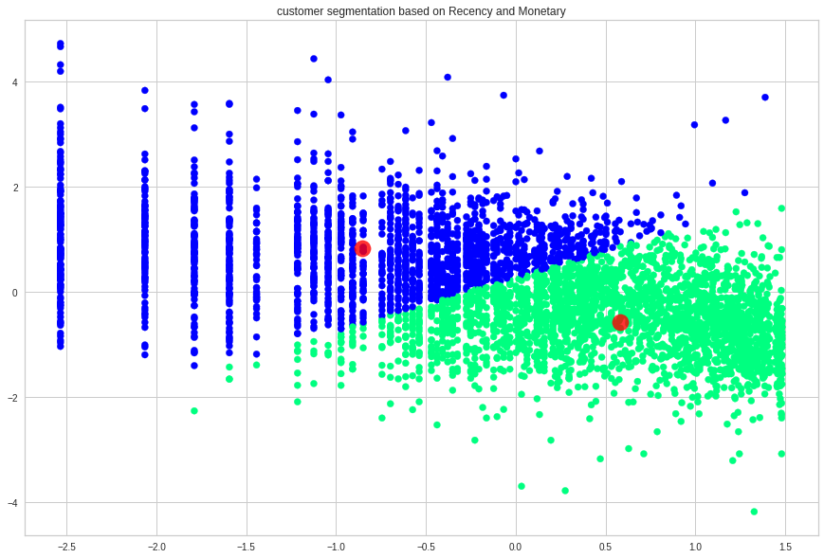
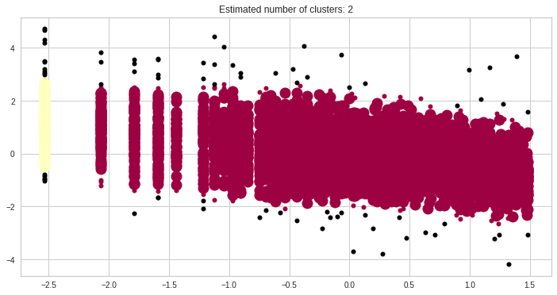
Customer Segmentation Based On Recency And Monetary
K MEANS
DBSCAN

Slide 27
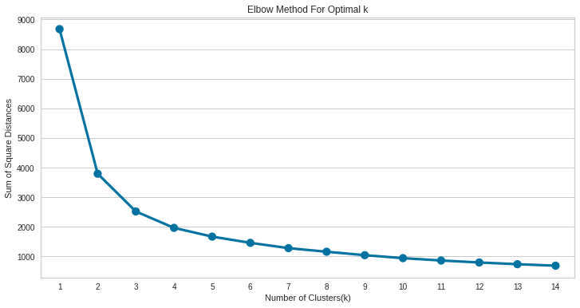
Frequency And Monetary
Here we can see that Optimal value for cluster came out to be 2

Slide 28
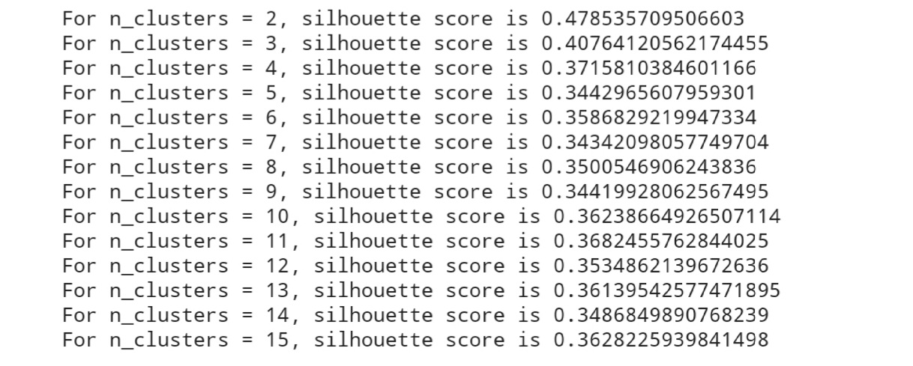
Silhouette Score
Here we can see the for n_cluster=2 silhouette score is good as compared to others.(if values is close to 1 means data points are clustered very well to respective clusters and distance of that data point is very far from the other cluster.)

Slide 29
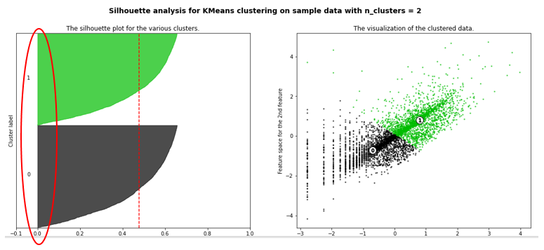
Silhouette Graph for n_cluster=2
Silhouette Plot for Frequency and Monetary with cluster=2 is very good as compared to Recency and Monetary's Silhouette plot.
No data points are on the negative side of the Silhouette Coefficient values

Slide 30
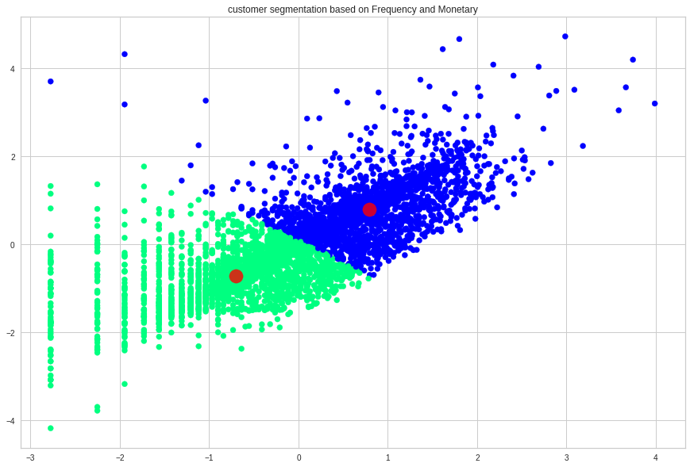
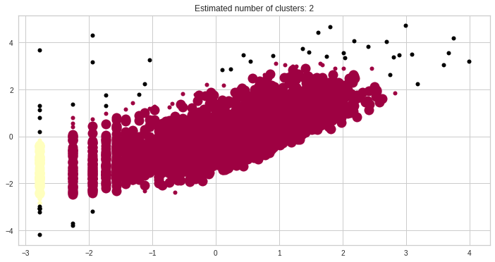
CUSTOMER SEGMENTATION BASED ON FREQUENCY AND MONETARY
K MEANS
DBSCAN

Slide 31
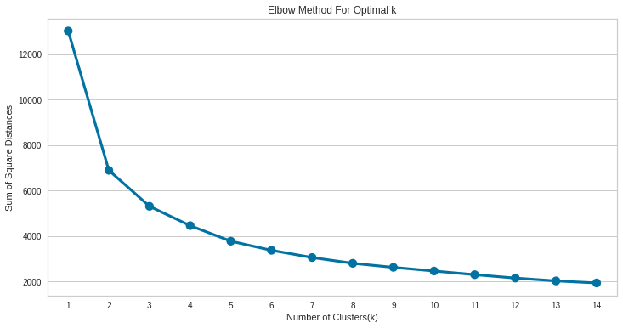
RECENCY FREQUENCY AND MONETARY:
ELBOW METHOD
Here we can see that Optimal value for cluster came out to be 2

Slide 32
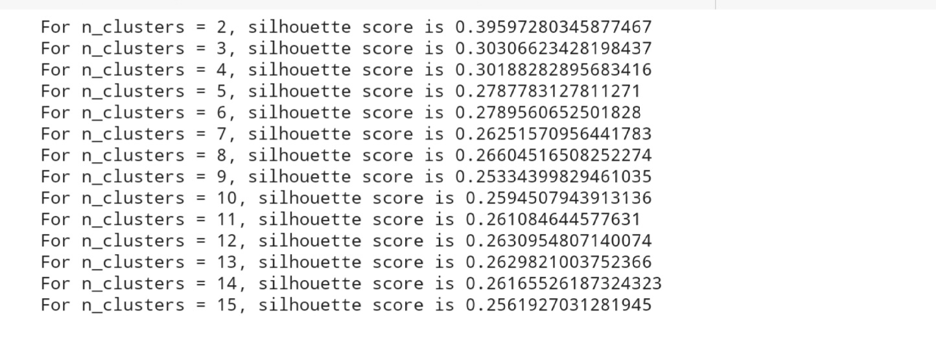
Silhouette Score
Here we can see the for n_cluster=2 silhouette score is good as compared to others.(if values is close to 1 means data points are clustered very well to respective clusters and distance of that data point is very far from the other cluster.)

Slide 33
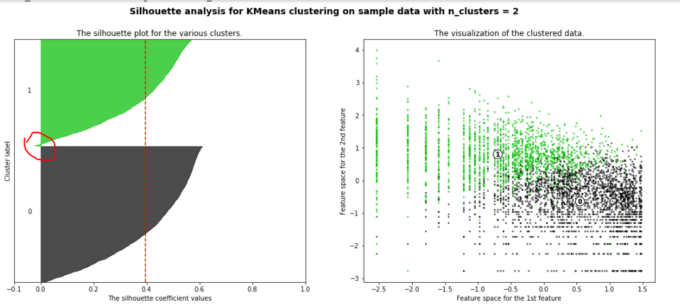
Silhouette plot for n_cluster=2
Silhouette Plot for Frequency and Monetary with cluster=2 is good.
Still Few data points are on the negative side of the Silhouette Coefficient values

Slide 34
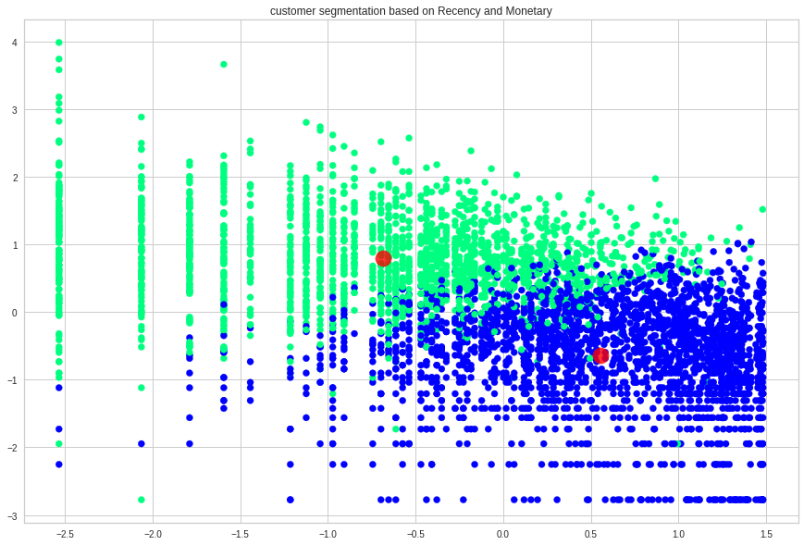
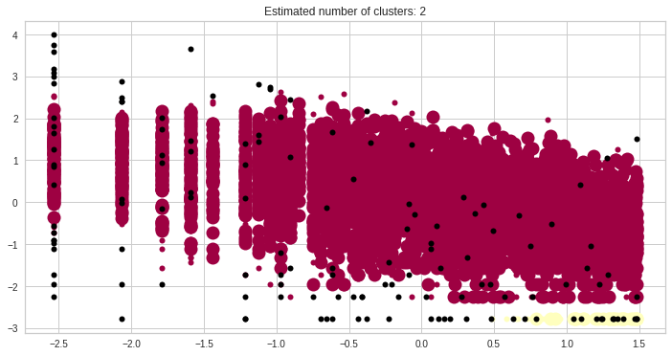
Customer Segmentation Based On RFM:
K MEANS FOR RFM
DBSCAN FOR RFM

Slide 35
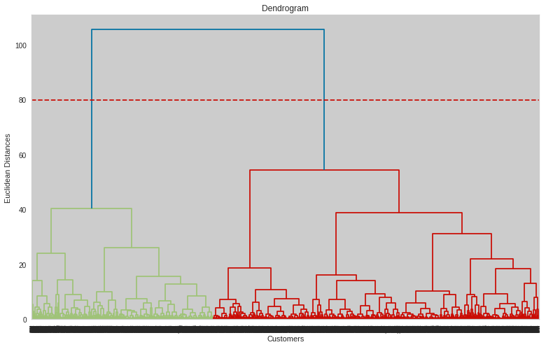
Hierarchical Clustering:
A dendrogram is a tree-like diagram that records the sequences of merges or splits. More the distance of the vertical lines in the dendrogram, more the distance between those clusters.
We can set a threshold distance and draw a horizontal line(Generally, set the threshold in such a way that it cuts the tallest vertical line)
The number of clusters will be the number of vertical lines which are being intersected by the line drawn using the threshold.
No. of Cluster = 2

Slide 36
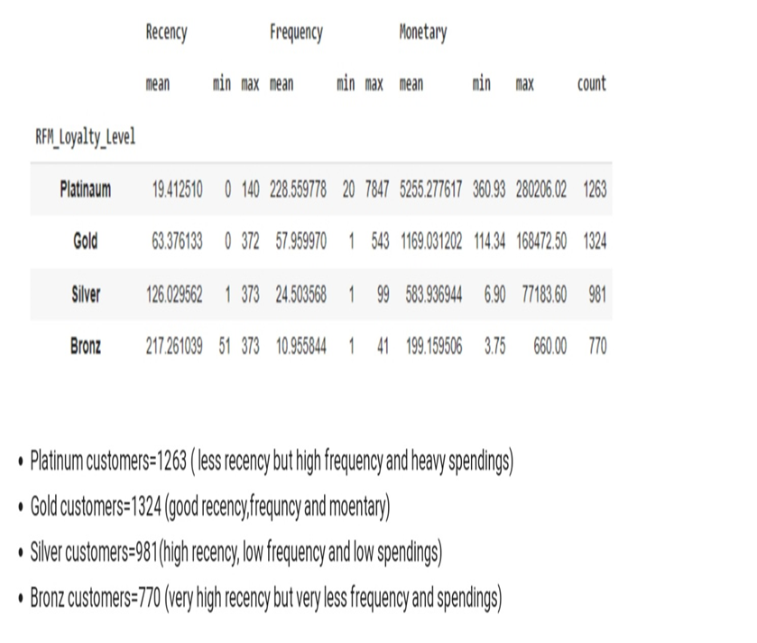
Summary: Firstly we did clustering based on RFM analysis. We had 4 clusters/Segmentation of customers based on RFM score

Slide 37
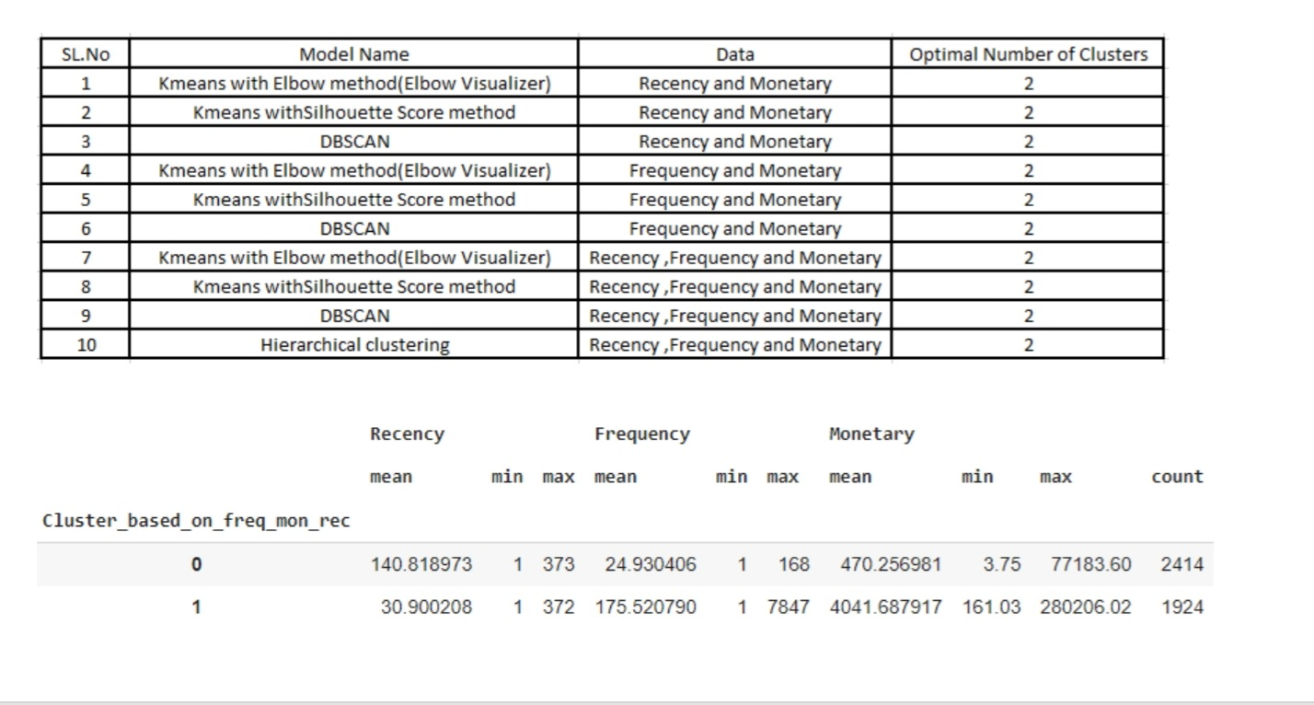
Later we implemented the machine learning algorithms to cluster the customers.

Slide 38
Conclusion:
Above clustering is done with recency, frequency and monetary data(K means Clustering) as all 3 together will provide more information.
Cluster 0 has high recency rate but very low frequency and monetary. Cluster 0 contains 2414 customers.
Cluster 1 has low recency rate but they are frequent buyers and spends very high money than other customers as mean monetary value is very high. Thus generates more revenue to the retail business

Slide 39
THANK YOU

